Slide 1
Covid-19: Sector Impact Phase Three Report: Recovery

Slide 2
Contents
2
Foreword
Contents
Summary
Workforce
Training Providers
Employer
References
3
4
5
9
13
17

Slide 3
Introduction
Sector Surveys
Throughout October and November, CIMSPA concluded their research in understanding how the sector is recovering from the extended Covid-19 restrictions with this final survey building on the feedback from the previous two surveys for:
Workforce
Understand the scale of the impact for everyone working within sport and physical activity and the opportunities arising from current working situations.
Training Providers
Understand the impact on the provision of training and the changes in accessibility and demand for the type of learning and development.
Employers
Understand the impact on small, medium and large employers across the sector and how different organisations are supporting their workforce.
3

Slide 4
Summary
Key Findings
Since reopening, 30% of workforce say the income is not sustainable. 40% say it is but only for a short period.
Only 4% of workforce feel they haven't been able to gain the support from sector bodies throughout COVID-19. 24% slightly or completely unclear on government guidelines.
The transition into digital delivery has been most challenging for training providers due to the guidelines around criteria for delivery and assessments.
4
Notes:
Link to the hub

Slide 5
WORKFORCE

Slide 6
Workforce
152
68% self-employed, 30 % employed and 2% other
responses
Finance
75% of the workforce state that they expect their income to decrease when less restrictive measures are in place.
46%
Support
Financial support for businesses has been crucial but access has been difficult.
“It's going to take a long time to generate the previous level of business. People are uncertain about returning to fitness facilities.”
able to work through or already back to work (mainly self-employed)
Using Furlough for staff
70%
12%
Future income is set to be:
Have not been able to access the
(non-financial) support they require
58%
Sustainable for a short period
16%
42%
Not sustainable
20%
Unsure
42%
30%
Fully sustainable
have had to find alternative work to replace or supplement their current job
need support rebuilding their business,
Through ReTrain £1.5m is available, funded by Sport England, to retool the sector’s workforce. A recent CIMSPA survey indicated up to 6% of the activity workforce are planning to leave the sector and ReTrain aims to combat this providing free training for new and existing staff enabling them to work in new areas.
Sport Wales have directly put out a funding pot for self-employed practitioners covering up to £1,500 for loss of earning.
30%
with a further stating that sector updates would also be beneficial.
60%
state that they have used some, or all
Only 12% of the workforce feel their future income is fully sustainable.
of their financial reserves.
On average, it will take the workforce 12 months
to recover to previous levels of income.
65% reported they would need further financial lending to support their business.
6
Notes:
Side by side

Slide 7
Workforce
152
68% self-employed, 30 % employed and 2% other
responses
90%
Return to Work
Guidelines which are confusing and difficult to access are making it harder for the workforce to restart business.
“The UK government seem to have put gyms into the same box as pubs. We are fully safe and now being forced to close again even though our industry saves the NHS millions every year by keeping people active and healthy (in a newly covid-secure way!)”
Business Finance
90% of Employers are experiencing a negative financial impact with the reasons for this being reported as:
have been negatively impacted, financially, since 1st March.
Unable to reopen to full service immediately
92%
10%
Facility Closure
Will require alternative work upon returning to their role
35%
15%
Average financial losses:
Learners Cancelling
£30k
Self-isolation
2x
75%
more workforce are fully aware of sector guidance than government guidelines.
45%
The Sport and Physical Activity sector is currently recognised as part of the Arts, Entertainment and Recreation sector by government. This has lead to misinterpretation of the sector, especially through the pandemic where the underestimation of job loss figures saw an initial lack of funding for the sector. Sports and Physical Activity industries make up around 61% of the wider Arts, Entertainment and Recreation sector. CIMSPA is currently collecting feedback from the sector on a piece of work to better define the sport and physical activity workforce which will help with future understanding of our sector.
85%
“The support from CIMSPA with guidance on opening and access to guidelines is in a much clearer format.”
Of the who have financial reserves,
on average, these will support their business for 15% do not have any financial reserves.
of employers currently paying rent. 15% of those are receiving pressure regarding rental payments.
4months.
51% of workforce rely on sector bodies (including CIMSPA) for information regarding a safe return to work..
7
Notes:
Side by side

Slide 8
Workforce
152
68% self-employed, 30 % employed and 2% other
responses
Wellbeing
Feedback regarding the perceived interest for wellbeing improvements to training:
Return to Work
Guidelines which are confusing and difficult to access are making it harder for the workforce to restart business.
“Health and fitness hasn’t been supported by the Government unfortunately, especially keeping us closed through Nov lockdown.”
Perspective
Highest indexing responses for the topics stated:
Already using mental wellbeing support for employees
70%
Unable to reopen to full service immediately
92%
Have adapted their product or service
77%
Will require alternative work upon returning to their role
35%
2x
“ Some clients are reluctant to come back to the class environment, but I also have new clients who now see fitness as a new essential part of life, and want to be fit to fight Covid.”
more workforce are fully aware of sector guidance than government guidelines.
COVID has had a negative
Impact on the profession
45%
“The support from CIMSPA with guidance on opening and access to guidelines is in a much clearer format.”
47% of workforce rely on sector bodies (including CIMSPA) for information regarding a safe return to work..
8
Notes:
Side by side

Slide 9
TRAINING PROVIDER

Slide 10
Training Providers
14
responses
Staffing & Finance
63% of training providers state that reopening under current measures will have a negative impact on their business.
28%
Support
Financial support for businesses has been crucial but access has been difficult.
“The industry has been hit hard which has a knock-on effect to our business. If the industry does not recover, we may not survive the next 6 months.”
have already had to make redundancies.
Using Furlough for staff
70%
Future income is set to be:
21%
Have not been able to access the
(non-financial) support they require
58%
Not sustainable
77%
37%
Sustainable for a short period
Fully sustainable
CIMSPA currently has a number of campaigns aiming to support Sport and Physical Activity organisations
Reactivate: Free online training platform designed to equip anyone working or volunteering in the sector with the knowledge they need to confidently deliver activities
Stronger together:
Support for you; help and advice for individuals working in the sector to help you get through this period, including mental health support
Support for your business; contributing to the resilience of businesses, small and large, within the sector
Support for the sector; what we are doing, along with others, to ensure the sector gets the support it needs from the government and elsewhere
Retrain: Free training for new and existing staff which will allow employers to continue providing valuable services to their local community
50%
28%
Unsure (14%)
agree that COVID-19 will greatly decrease their income.
reduction of learners is expected.
86%
On average, training providers currently employ between 10 – 20 staff.
“We need to see demand from employers rather than individuals increase.”
state that they have used some, or all
of their financial reserves.
On average, it will take training providers
12 months to recover to previous levels of income.
65% of employees appear to be relaxed or excited to return to work.
10
Notes:
Side by side

Slide 11
Training Providers
14
responses
28%
Return to Work
Limited understanding of Government guidelines and advice
Staffing & Finance
63% of training providers state that reopening under current measures will have a negative impact on their business.
have already had to make redundancies.
Unable to provide all of their training online
93%
Future income is set to be:
21%
Not sustainable
Not fully aware of procedures for safe reopening / practice
40%
“If I have to close, I'll be forced to work against guidelines or get into more and more debt. It's depressing.”
77%
37%
Sustainable for a short period
Fully sustainable
50%
28%
Unsure (14%)
agree that COVID-19 will greatly decrease their income.
reduction of learners is expected.
86%
On average, training providers currently employee between 10 – 20 staff.
“We need to see demand from employers rather than individuals increase.”
state that they have used some, or all
of their financial reserves.
On average, it will take training providers 12 months to recover to previous levels of income.
40% of training providers expect to use bounce back loans to assist with reopening.
11
Notes:
Side by side

Slide 12
Training Providers
14
responses
Wellbeing
Feedback regarding the perceived interest for wellbeing improvements to training:
Perspective
Highest indexing responses for the topics stated:
“Many of my learners are extremely anxious about being in a group environment.”
Already using mental wellbeing support for employees
70%
Training providers feeling anxious /
nervous to reopen business
77%
“The media portrays gyms as dirty.”
COVID has had a negative
Impact on the profession
68%
The Sport and Physical Activity sector has conducted itself immensely throughout the pandemic and it’s vital that we continue to do so and demonstrate this to shift the public perception.
12
Notes:
Side by side

Slide 13
EMPLOYER

Slide 14
Employer
6
3 x fitness facilities, 2 x school facilities and 1 x leisure operator
responses
Staffing & Finance
84% of employers state that the current guidance measures regarding reopening have limited the revenue they can generate.
67%
Support
Financial support for businesses has been crucial but access has been difficult.
have staff currently furloughed.
Using Furlough for staff
70%
Future income is set to be:
“It’s difficult working out how to remain financially viable with reduced class sizes. We have a small fitness suite that can only host 6 people when socially distanced.”
16%
Have not been able to access the
(non-financial) support they require
58%
Sustainable for a short period
100%
16%
Fully sustainable
Unsure
42%
68%
agree that COVID-19 will continue to impose a negative financial effect on their business.
need support rebuilding their business,
30%
with a further stating that sector updates would also be beneficial.
65%
state that they have used all
of their financial reserves.
42% of employers expect to utilise government loans or grants upon reopening.
On average, it will take employers 12 months
to recover to previous levels of income.
65% reported they would need further financial lending to support their business.
14
Notes:
Side by side

Slide 15
Employer
6
3 x fitness facilities, 2 x school facilities and 1 x leisure operator
responses
Although most facilities will be reopening, many will rely on further financial support to keep business which will implicate the level of future certainty many organisations have. More financial support is needed to assist facilities in enduring periods whereby restrictions limit service levels.
Return to Work
Over half of employers will be using or relying on the job retention scheme upon reopening
Business Finance
90% of Employers are experiencing a negative financial impact with the reasons for this being reported as:
90%
have been negatively impacted, financially, since 1st March.
Fully aware of procedures for safe return to work
84%
10%
Will use job retention scheme
65%
“We have spent time training and understanding their (employees’) concerns. We have gotten them involved in writing action plans so they know what is happening and fully back it.”
15%
Facility Closure
Average number of employees = 12
Learners Cancelling
Average financial losses:
£30k
Self-isolation
40%
75%
45%
reduction of members is expected.
40% reduction in members is unsustainable. More support is needed to restore public confidence in how facilities are working to ensure safe and secure environments.
Over three quarters of respondents stated they intend to return to clubs immediately, another 21% saying January/February and only 3% saying never with 69% of people saying they are ‘extremely confident’ after returning to their club post lockdown. The National Post Lockdown 2.0 Recovery Survey, Leisure-Net
Businesses are not currently able to confirm how they will make up for lost income in the future.
85%
Of the who have financial reserves,
on average, these will support their business for 15% do not have any financial reserves.
of employers currently paying rent. 15% of those are receiving pressure regarding rental payments.
4months.
65% said that their employees appear to be relaxed or excited to return to work
15
Notes:
Side by side

Slide 16
Employer
6
3 x fitness facilities, 2 x school facilities and 1 x leisure operator
responses
responses
Perspective
Highest indexing responses for the topics stated:
COVID has had a negative
Impact on the profession
68%
“Most employees are worried about the rules and understanding why we have put things in place. The rules seem to change every few weeks and we are struggling to put plans in place before they change again.”
Employers feeling anxious /
nervous to reopen business
50%
16
Notes:
Side by side

Slide 17
RESOURCES

Slide 18
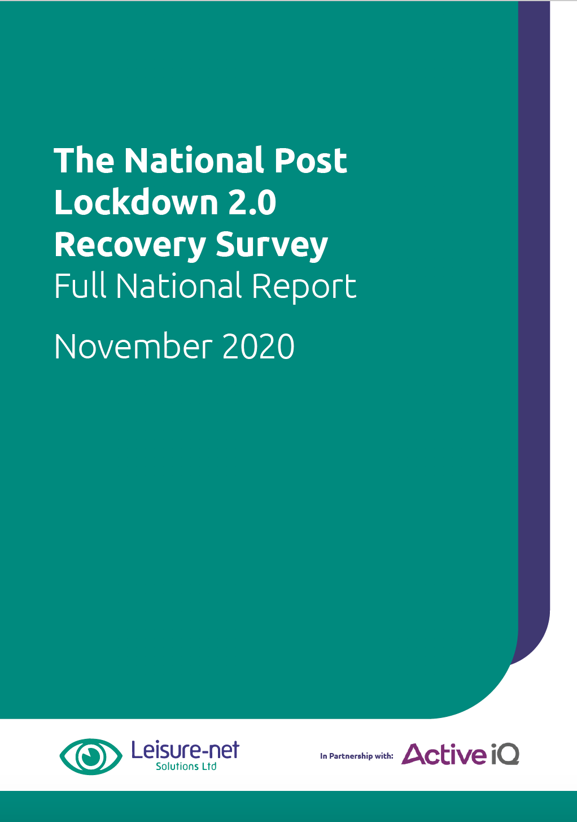
References
Workforce Support
D. Monkhouse (Leisure-net)
Stronger Together CIMSPA Supporter campaign – Via The Hub:
Offers the sector workforce support through heavily discounted and free products/services to maintain some degree of continuity whether that is engagement, courses, planning for reopening etc.
www.cimspa.co.uk
18

